Slide 1
Cellular Networks - 2

Slide 2
Generations

Slide 3
Data Rates
2 Mbps
1 Mbps
3G
(144Kbps to 2Mbps)
100 Kbps
2.5G
(10-150Kbps)
10 Kbps
2G
(9.6Kbps)
1 Kbps
1G
(<1Kbps)
1980
1990
2000
2010
Years

Slide 4
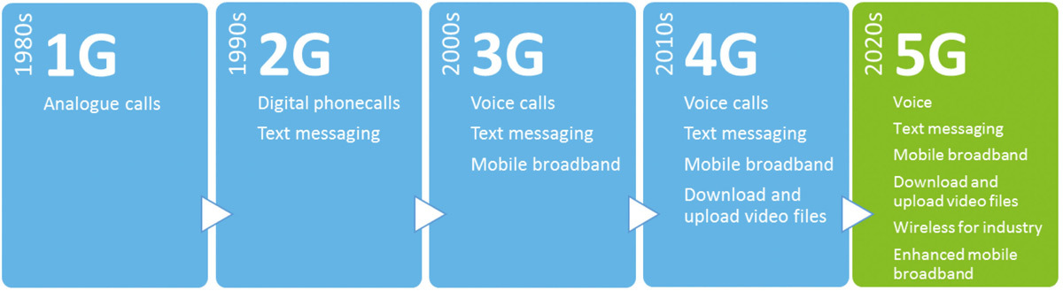
D-AMPS, GSM/GPRS,
cdmaOne
Digital Voice / Simple Data
CDMA2000/EV-DO,
WCDMA/HSPA+, TD-SCDMA
Mobile Broadband
AMPS, NMT, TACS
Analog voice
LTE, LTE Advanced
Faster, better, richer content, more connections

Slide 5
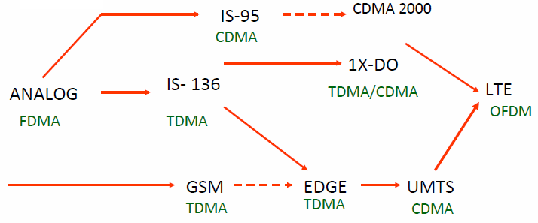
1G
2G
2.5G
3G
4G

Slide 6
Cellular 1G
Mobile 1G established the foundation of cellular networks in the following three ways:
Licensed Spectrum
Cleared spectrum for exclusive use by mobile technologies
Operator-deployed base stations provide access for subscribers
Frequency Reuse
Reusing frequencies without interference through geographical separation
Neighboring cells operate on different frequencies to avoid interference
Mobile Network
Coordinated network for seamless access and seamless mobility
Integrated, transparent backhaul network provides seamless access

Slide 7
Cellular 1G
Advanced Mobile Phone Service (AMPS) invented at Bell Labs and first installed in 1982
Used in England (called TACS) and Japan (called MCS-L1)

Slide 8
Limitations of 1G
Requires large gap of spectrum between users to avoid interference
Frequency Division Multiple Access (FDMA)
Support for only 1 user per channel (because it transmits only analog signal)
Limited capacity
Inefficient at using limited spectrum
Limited scalability
Analog devices are large/heavy, power inefficient, and high cost

Slide 9
Cellular 2G
Initial 2G technologies (D-AMPS, GSM) based on TDMA
Digital voice compressed into smaller ``packages’’
Rigid delivery schedule whether or not the user is actively talking
Support for more than one user per channel
Voice compression and multiplexing multiple users per channel
Scalable Technology – cost, as well as weight of digital components are far less and deliver more secure signal

Slide 10
Cellular 2G
Different approaches in US and Europe
US: divergence
Only one player (AMPS) in 1G
Became several players in 2G due to competition
Survivors
IS-54 and IS-135: backward compatible with AMPS frequency allocation (dual mode - analog and digital)
IS-95: uses spread spectrum
Europe: Convergence
5 incompatible 1G systems (no clear winner)
European PTT development of GSM (uses new frequency and completely digital communication)

Slide 12
Limitations of 2G
TDMA still required large frequency gaps to reduce interference
Also required potentially unreliable “hard” handoffs

Slide 13
Cellular 3G
CDMA established the foundation for 3G technologies
Two competing standards based on CDMA
CDMA2000 - July 2000 (Revision A) - Uses 1.25 MHz carrier;
WCDMA (UMTS) - June 2001 (Release 99) - Uses 5 MHz carrier; leverages GSM core network
CDMA 2000 evolved to EV-DO (Evolution-Data Optimized)
Optimized data channel for CDMA2000 providing mobile broadband services
October 2000 (Release 0)
WCDMA evolved to HSPA (High Speed Packet Access)
Optimized data channel for WCDMA providing mobile broadband services
June 2004 (Release 5)

Slide 14
Simple Data Services
- Text, email etc.
Mobile Broadband
- Multimedia
Browsing
Navigation
Apps

Slide 15
Cellular 3G
Cellular 3G evolved to HSPA+ and EV-DO Rev. B
Higher Order Modulation (HOM)
Introduces 64-QAM enabling 50% more bits per second per Hz (bps/Hz)
Carrier Aggregation
Aggregating spectrum enabling increased number of users and peak data rates

Slide 16
Limitations of CDMA Cellular
Self-jamming – codewords from multiple users are not perfectly orthogonal, as a result they produce large interference
Near-far problem – signals closer to the receiver are received with less attenuation than signals farther away
Soft handoff – the mobile acquires the new cell before it relinquishes the old; this is more complex than hard handoff used in FDMA and TDMA schemes

Slide 17
Cellular 4G LTE
Flexible support for wider channels supporting more users
Flexible support for channels up to 20 MHz enabled with OFDMA
Create spatially separated paths with more antennas
Advanced MIMO techniques to create spatially separated paths
Aggregate channels for higher data rates
Aggregate up to 100 MHz for higher data rates – 2 carrier (2C) commercial; 3C announced
Simplified Core Network - all IP network with flattened architecture resulting in less equipment per transmission
Low Latencies - optimized response times for both user and control plane improves user experience

Slide 18
Cellular 4G LTE
Two modes and common standard – LTE FDD, LTE TDD

Slide 19
3G and 4G technologies are evolving for more data capacity

Slide 20
GSM

Slide 21
GSM
Formerly known as Groupe Spéciale Mobile (founded 1982)
Now: Global System for Mobile Communication
Pan-European standard (ETSI, European Telecommunications Standardisation Institute)

Slide 22
GSM Architecture
GSM is a PLMN (Public Land Mobile Network)
several providers setup mobile networks following the GSM standard within each country
components
MS (mobile station)
BS (base station)
MSC (mobile switching center)
LR (location register)
subsystems
RSS (radio subsystem): covers all radio aspects , also sometimes called as the Base Station Subsystem (BSS)
NSS (network and switching subsystem): call forwarding, handover, switching
OSS (operation subsystem): management of the network

Slide 23
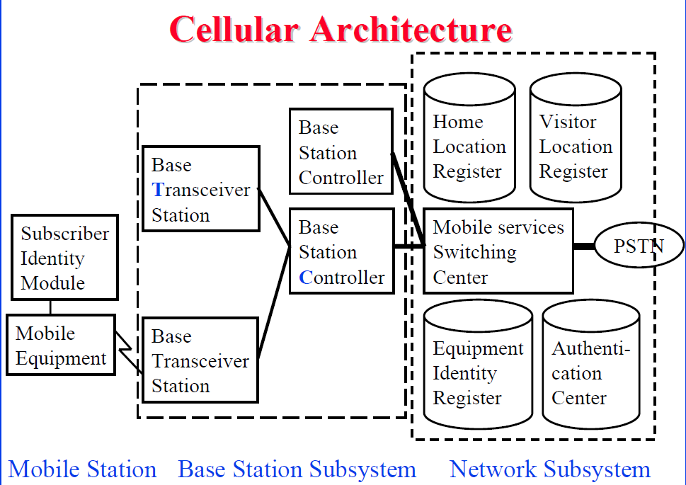

Slide 24
System architecture: radio subsystem
Components
MS (Mobile Station)
BSS (Base Station Subsystem): consisting of
BTS (Base Transceiver Station): sender and receiver
BSC (Base Station Controller): controlling several transceivers
Interfaces
U_{m} : radio interface
A_{bis} : standardized, open interface with 16 kbit/s user channels
A: standardized, open interface with 64 kbit/s user channels

Slide 25
GSM Frequency bands

Slide 26
GSM Radio Interface

Slide 27
Tail bits are set to 0 and can be used to enhance the receiver performance
Training sequence is used to adapt the parameters of the receiver to the current path propagation characteristics and to select the strongest signal in case of multipath propagation
Flag S indicates whether the data field contains user or network control data

Slide 28
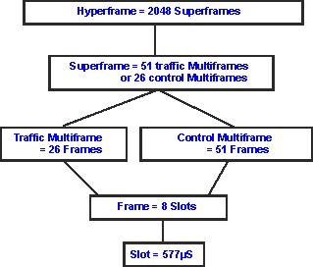
GSM Frame Structure

Slide 29
GSM slot and burst
GSM burst
The GSM burst, or transmission can fulfil a variety of functions.
Some GSM bursts are used for carrying data while others are used for control information.
Different types of GSM burst are:
Normal burst - uplink and downlink
standard communications between the basestation and the mobile, and typically transfers the digitised voice data.
Synchronisation burst – downlink
provide synchronisation for the mobiles on the network.
Frequency correction burst - downlink
Access burst (Shortened Burst) – uplink
Initial connection setup between the MS and the BTS

Slide 30
Base Station Subsystem
Transcoding Rate and Adaptation Unit (TRAU)
Used to compress and de-compress the speech data. Not used for data connection.
Performs coding between the 64kbps PCM coding used in the backbone network and the 13 kbps coding used for the Mobile Station (MS)
Base Station Controller (BSC)
Controls the channel (time slot) allocation implemented by the BTSs
Manages the handovers within BSS area
Knows which mobile stations are within the cell and informs the MSC/VLR about this
Base Transceiver System (BTS)
Controls several transmitters
Each transmitter has 8 time slots, some used for signaling, on a specific frequency

Slide 31
Base Transceiver Station and Base Station Controller
Tasks of a BSS are distributed over BSC and BTS
BTS comprises radio specific functions
BSC is the switching center for radio channels

Slide 32
Network and Switching Subsystem
The backbone of a GSM network is a telephone network with additional cellular network capabilities
Mobile Switching Center (MSC)
A typical telephony exchange (ISDN exchange) which supports mobile communications
Visitor Location Register (VLR)
A database, part of the MSC
Contains the location of the active Mobile Stations
Gateway Mobile Switching Center (GMSC)
Links the system to PSTN and other operators
Home Location Register (HLR)
Contains subscriber information, including authentication information in Authentication Center (AuC)
Equipment Identity Register (EIR)
The EIR is the entity that decides whether a given UE equipment may be allowed onto the network.
Each UE equipment has a number known as the International Mobile Equipment Identity. This number is installed in the equipment and is checked by the network during registration.

Slide 33
Home Location Register
One database per operator
Contains all the permanent subscriber information
MSISDN (Mobile Subscriber ISDN number) is the telephone number of the subscriber
International Mobile Subscriber Identity (IMSI) is a 15 digit code used to identify the subscriber
It incorporates a country code and operator code
IMSI code is used to link the MSISDN number to the subscriber’s SIM (Subscriber Identity Module)
Charging information
Services available to the customer
Also the subscriber’s present Location Area Code, which refers to the MSC, which can connect to the MS.

Slide 34
Other Systems
Operations Support System
The management network for the whole GSM network
Usually vendor dependent
Very loosely specified in the GSM standards
Value added services
Voice mail
Call forwarding
Group calls
Short Message Service Center
Stores and forwards the SMS messages
Like an E-mail server
Required to operate the SMS services

Slide 35
Location Updates
The cells overlap and usually a mobile station can `see’ several transceivers (BTSes)
The MS monitors the identifier for the BSC controlling the cells
When the mobile station reaches a new BSC’s area, it requests a location update
The update is forwarded to the MSC, entered into the VLR, the old BSC is notified and an acknowledgement is passed back

Slide 36
Handoff (Handover)
4 types of handoff
When a call is in process, the changes in location need special processing
Within a BSS, the BSC, which knows the current radio link configuration (including feedbacks from the MS), prepares an available channel in the new BTS
The MS is told to switch over to the new BTS
hard handoff

Slide 37
Handover procedure – Intra MSC

Slide 38
General Packet Radio Service (GPRS)
GSM upgrade that provides IP-based packet data transmission up to 114 kbps
Users can “simultaneously” make calls and send data
GPRS provides “always on” Internet access and the Multimedia Messaging Service (MMS) whereby users can send rich text, audio, video messages to each other
Performance degrades as number of users increase
GPRS is an example of 2.5G telephony – 2G service similar to 3G

Slide 39
UMTS

Slide 40
GSM System is TDMA-based

Slide 41
UMTS System is CDMA-based

Slide 43
WCDMA
principles of the WCDMA air interface:
Spreading – Direct Sequence Spreading
Rake receiver
designed to counter the effects of multipath fading. It does this by using several "sub-receivers" called fingers.
Power control
ensures that each user receives and transmits just enough energy to prevent
blocking of distant users
exceeding reasonable interference levels
Handover

Slide 44
UMTS
Universal Mobile Telecommunications System (UMTS)
UMTS is an upgrade from GSM via GPRS or EDGE
The standardization work for UMTS is carried out by Third Generation Partnership Project (3GPP)
Data rates of UMTS are:
144 kbps for rural
384 kbps for urban outdoor
2048 kbps for indoor and low range outdoor
Virtual Home Environment (VHE)
a system concept for personalised service portability across network boundaries and between terminals
users are consistently presented with the same personalised features, user Interface capabilities and services irrespective of networks, terminals, and user locations

Slide 45
UMTS Architecture

Slide 46
UMTS Architecture
Three main elements:
User Equipment (UE): Mobile station or cellphone
Radio Network Subsystem (RNS): also known as the UMTS Radio Access Network, UTRAN (equivalent to Base Station Subsystem or BSS in GSM). It provides and manages the air interface for the overall network.
Core Network: The core network provides all the central processing and management for the system (equivalent to the GSM Network Switching Subsystem or NSS)
UMTS core network may be split into two different areas:
Circuit switched elements: primarily based on the GSM network entities and carry data in a circuit switched manner (i.e. a permanent channel for the duration of the call)
Packet switched elements: designed to carry packet data.
Enables much higher network usage as the capacity can be shared and data is carried as packets which are routed according to their destination

Slide 47
UMTS Architecture
Circuit switched elements
Mobile switching centre (MSC): same as that of GSM
Gateway MSC (GMSC): effectively the interface to the external networks
Packet switched elements
Serving GPRS Support Node (SGSN): was first developed when GPRS was introduced
provides a number of functions within the UMTS network architecture, such as
Mobility management
Session management
Interaction with other areas of the network
Billing
Gateway GPRS Support Node (GGSN)
was also first introduced into the GPRS network
handles inter-working between the UMTS packet switched network and external packet switched networks
when the GGSN receives data addressed to a specific user, it checks if the user is active and then forwards the data to the SGSN serving the particular UE

Slide 48
UMTS Architecture
Shared elements
Home location register (HLR)
Equipment identity register (EIR)
Authentication centre (AuC)
As in case of GSM, here it is a protected database that contains the secret key that is also contained in the user's USIM card.

Slide 49
Mobile Radio Propagation

Slide 50
Mobile Radio Propagation Effects
Signal strength
Strength of signal between BS and mobile unit must be strong enough to maintain signal quality at the receiver
Should not be strong enough to create too much cochannel interference
Effect of noise
Automobile ignition noise greater in city than in suburbs
Other signal sources may be present
Signal strength varies as function of distance from BS
Signal strength varies dynamically as mobile unit moves
Fading
Even if signal strength is in effective range, signal propagation effects may disrupt the signal

Slide 51
Design Considerations
Propagation effects
Dynamic
Hard to predict
Maximum transmission power level at BS and mobile units
Typical height of mobile unit antenna
Available height of the BS antenna
The above factors determine size of individual cell
Models are developed based on empirical data
Models are applied to given environment to develop guidelines for cell size
E.g. model by Okumura et al refined by Hata
Detailed analysis of Tokyo area
Produced path loss information for an urban environment
Hata's model is an empirical formulation
Takes into account variety of environments and conditions

Slide 52
Fading
Rapid fluctuations of received signal strength over short time intervals and/or travel distances
Caused by changes in transmission path(s)
E.g. atmospheric conditions (rain)
Movement of (mobile unit) antenna

Slide 53
Multipath Propagation
The signal takes many paths to the destination. The propagation delay along each path is different
Causes
Reflection
Diffraction
Scattering

Slide 54
Multipath Propagation
Reflection
Occurs when signal encounters a surface that is large relative to the wavelength of the signal
Occurs from the surface of earth and from buildings and walls
May have phase shift from original
May cancel out original or increase it
Diffraction
Occurs when the radio path between the transmitter and receiver is obstructed by a surface with sharp irregularities (or edges)
The secondary waves resulting from the obstructing surface are present throughout the space and even behind the obstacle
May receive signal even if the receiver is not at line of sight (LOS) with transmitter

Slide 55
Multipath Propagation
Scattering
Occurs when the medium through which the wave travels consists of objects that are small compared to the wavelength, and
The number of objects per unit volume is large
Occurs when incoming signal hits an obstacle, such as lamp posts etc.
If there is LOS, diffracted and scattered signals are not significant
Reflected signals may be
If no LOS, diffraction and scattering are primary means of reception

Slide 56
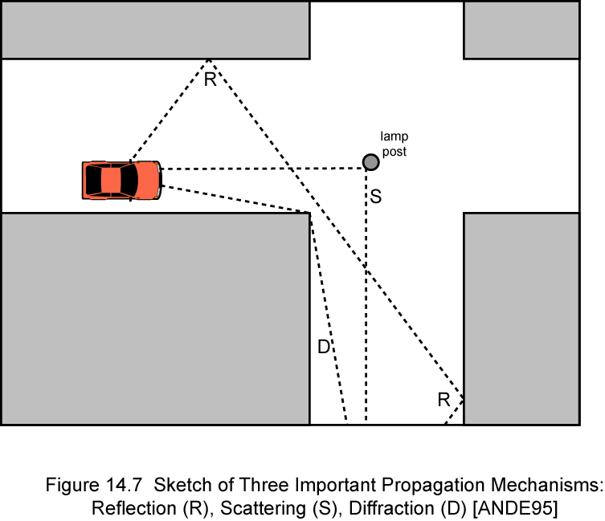
Reflection, Diffraction and Scattering

Slide 57
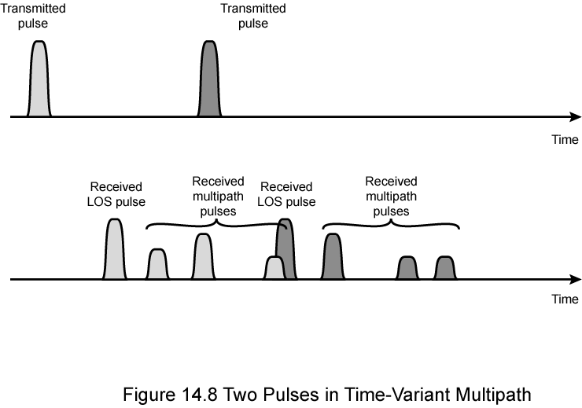
Multipath Propagation
Effects
Multiple copies of a signal may arrive at different phases
If phases add destructively, the signal level relative to noise declines, making detection more difficult
Intersymbol interference (ISI)
One or more delayed copies of a pulse may arrive at the same time as the primary pulse for a subsequent bit

Slide 58
Fading
Fast fading
rapid changes in strength over distances about half wavelength
represented by the rapid fluctuations of the signal over small areas
Slow fading
Slower changes due to user passing different height buildings, gaps in buildings etc.
Over longer distances than fast fading
Flat fading
Nonselective
Affects all frequencies in same proportion
Selective fading
Different frequency components are affected differently

Slide 59
Error Compensation Mechanisms
Forward error correction
Applicable in digital transmission applications
Adaptive equalization
Applied to transmissions that carry analog or digital information
Used to combat intersymbol interference
Gathering the dispersed symbol energy back together into its original time interval
Techniques include analog circuits and sophisticated digital signal processing algorithms

Slide 60
Error Compensation Mechanisms
Diversity
Based on the fact that individual channels experience independent fading events and interferences
The schemes provide multiple logical channels between transmitter and receiver
More commonly, diversity refers to frequency or time diversity
Frequency diversity: Send part of signal over each channel
Space diversity: May involve different physical transmission path
Multiple nearby antennas receive message or collocated multiple directional antennas
Doesn’t eliminate errors, however reduce error rate

Slide 61
OFDM (Orthogonal Frequency Division)
Basic Concept
Usual FDM
Orthogonal FDM

Slide 62
OFDM (Orthogonal Frequency Division)
Multiple sub-channels (sub-carriers) carry samples sent at a lower rate
Almost same bandwidth with wide-band channel
Only some of the sub-channels are affected by interferers or multi-path effect

Slide 63
Why not just use FDM
Not orthogonal
Leakage interference from adjacent sub-­‐channels
Need guard bands between adjacent frequency bands
causes extra overhead and lower throughput

Slide 64
Orthogonal FDM
Properties
Lower data rate on each subcarrier
Less interference
interference on one frequency results in interference of one subcarrier only
no guard space necessary
orthogonality allows signal separation via inverse FFT on receiver side
precise synchronization necessary (sender/receiver)
Advantages
no equalizer necessary
no expensive filters with sharp edges necessary
better spectral efficiency (optimized use of spectrum) compared to CDM

Slide 65
55 60 56 28 59

